Slide 1




MOTIVATION
Why agentic coding tools exist
Claude Code on its own is great, but it leaves four problems on the table:
01 · NOTIFICATIONS
02 · UI
Agentic notifications
Agent-first interface
Agents block on questions and run for minutes. You need to be pinged, not stare at a terminal.
The screen is for reviewing diffs and steering runs, not editing files. The IDE moves to the background.
03 · ISOLATION
04 · CONTEXT
Branching & worktrees
Better context & integrations
Running multiple agents at once means automatic worktrees or containers so they don't clobber each other.
Feeding the right files, MCPs, skills, and project state into every agent automatically.
01 / 09

Slide 2
SCOPE-SETTER
What they don't do
These tools route agents and their responses. They are not the agent — keep expectations honest:
01
Don't write the code
02
Don't fix a bad agent
Claude Code / Codex still do that. A nicer dashboard around a weak agent is still a weak agent.
If the underlying CLI hallucinates, no amount of orchestration saves the run. Garbage in, parallel garbage out.
03
Don't manage your environment
04
Don't replace your IDE
Secrets, dependencies, runtimes, and infra are still yours. Container-based tools help, but you set them up.
Diff review is great, but real code reading and surgery still happen in your editor. These tools sit beside it.
02 / 09

Slide 3
LANDSCAPE
Three decisions that define the category
Every tool here is a different combination of these three choices.
WHERE THE AGENT RUNS
HOW ISOLATION WORKS
WHAT THE UI IS
Run location
Isolation model
UI surface
Local
Git worktrees
Desktop only
Conductor · Sculptor · Paseo
Conductor · Paseo · Omnara
Conductor · Sculptor
Self-hosted
Containers
Cross-device
Paseo (your VM)
Sculptor (Docker)
Paseo · Omnara
Cloud
Cloud sandbox
Mobile-first
Omnara · PocketEng
PocketEng · cloud workers
PocketEng
03 / 09

Slide 4
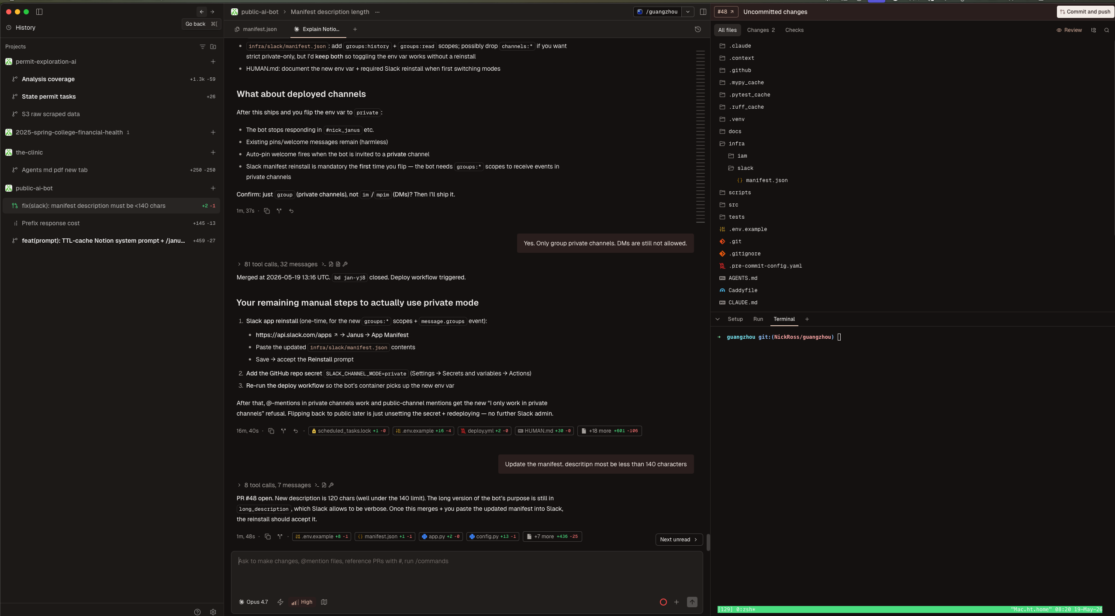
TOOL · 01
Conductor
Run a team of coding agents on your Mac — the polished desktop command center.
POSITION ON THE 3 AXES
Runs on
Local
Isolation
Git worktrees
SCREENSHOT
UI
Desktop only
Paste Conductor screenshot here
WHAT IT'S FOR
Sitting at your machine and running many Claude Code + Codex agents in parallel. Best diff-review UX in the category. Mature; ~$24M raised (Melty Labs, YC S24).
conductor.build
04 / 09

Slide 5
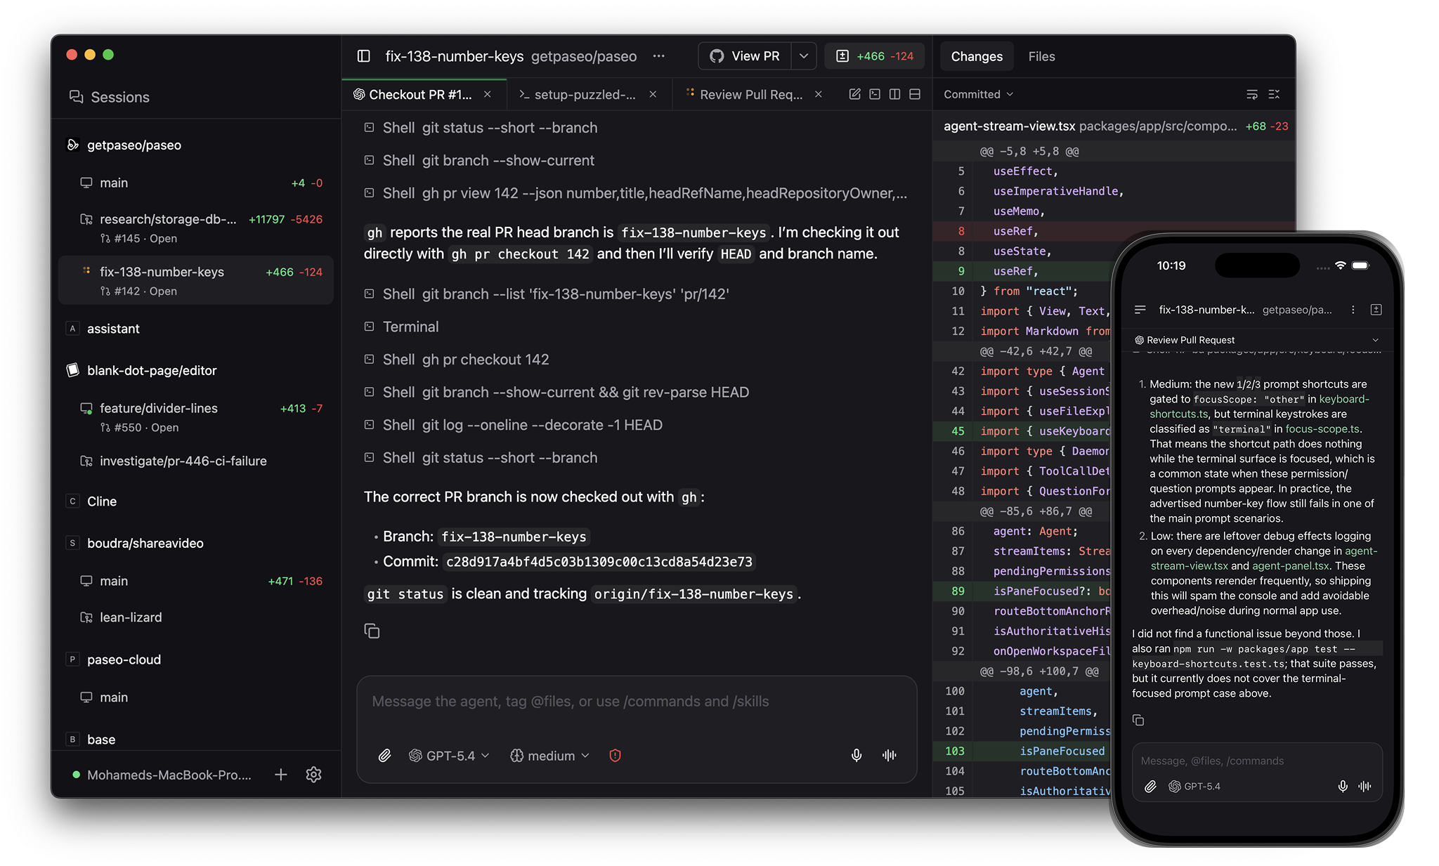
TOOL · 02
Paseo
Open-source self-hosted daemon for running 30+ agent CLIs from any device.
POSITION ON THE 3 AXES
Runs on
Local / your VM
Isolation
Worktrees (opt.)
SCREENSHOT
UI
Cross-device
Paste Paseo screenshot here
WHAT IT'S FOR
Privacy-first, multi-provider power users. Run Claude Code, Codex, OpenCode and many more from desktop, web, mobile or CLI — daemon stays on your machine. Free / OSS.
paseo.sh
05 / 09

Slide 6
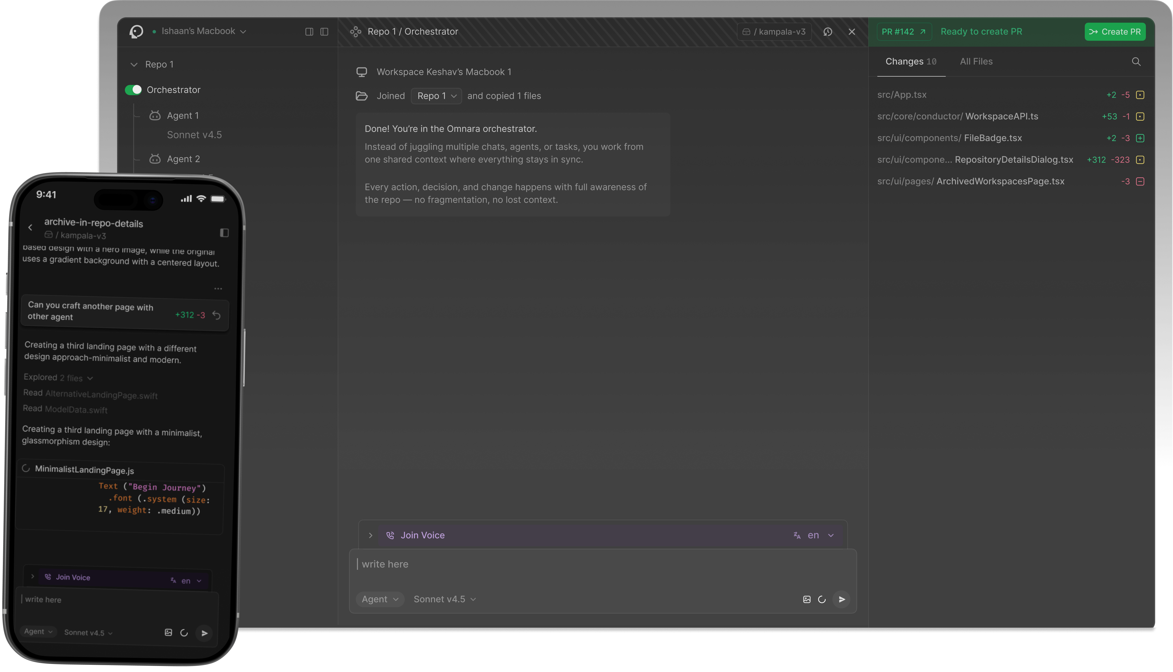
TOOL · 03
Omnara
Command center for reach — push alerts, voice, and sessions that survive a sleeping laptop.
POSITION ON THE 3 AXES
Runs on
Local + cloud
Isolation
Worktrees + Git
SCREENSHOT
UI
Cross-device
Paste Omnara screenshot here
WHAT IT'S FOR
Supervising agents away from your desk. Push notifications when input is needed, voice-first interaction, persistent sessions. YC S25; free tier + $9/mo Pro.
Mobile + web showing a Claude Code session with notifications and diff
omnara.com
06 / 09

Slide 7
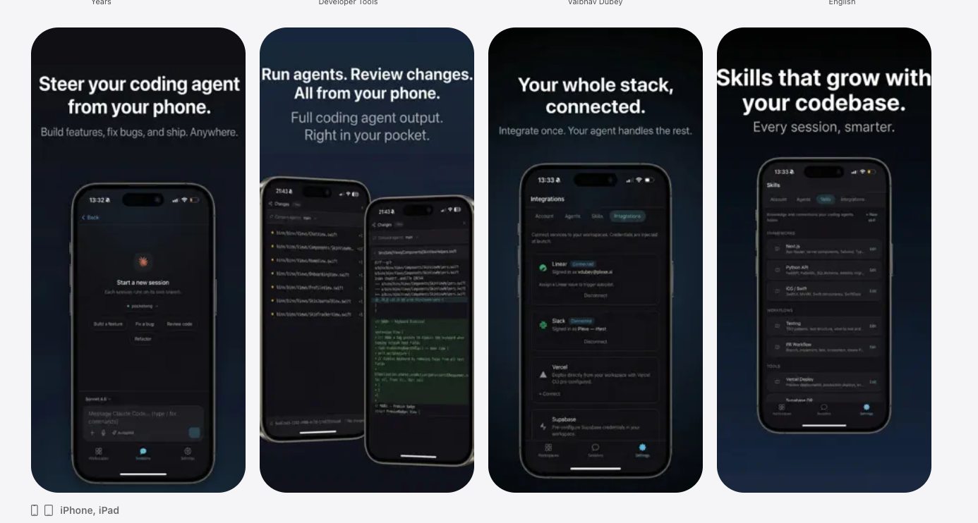
TOOL · 04
PocketEng
Cloud dev workspaces steered from iOS — the lightest, phone-first take.
POSITION ON THE 3 AXES
Runs on
Cloud workspaces
Isolation
Cloud sandbox
SCREENSHOT
UI
Mobile-first
Paste PocketEng screenshot here
WHAT IT'S FOR
Kicking off and reviewing agent work entirely from your phone. Earliest-stage of the bunch — solo indie project; lightweight feature set. Free.
iPhone screen showing a coding session, diff, or agent chat
pocketeng.ai
07 / 09

Slide 8
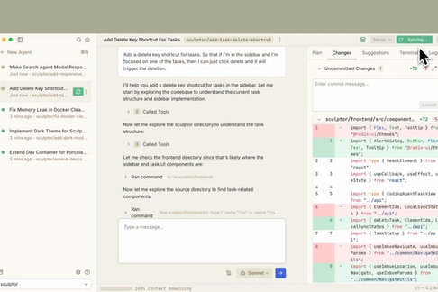
TOOL · 05
Sculptor
Desktop UI for parallel agents — each one in its own Docker container.
POSITION ON THE 3 AXES
Runs on
Local
Isolation
Containers (Docker)
SCREENSHOT
UI
Desktop + IDE
Paste Sculptor screenshot here
WHAT IT'S FOR
The architecturally distinct option: container isolation instead of worktrees, plus Pairing Mode that syncs an agent's work into your IDE. By Imbue. Free in beta.
Sculptor desktop UI with multiple parallel agent containers + Pairing Mode
imbue.com/sculptor
08 / 09

Slide 9
LANDSCAPE
Issues / Problems
Managing git flow
  Agents aren’t aware of each other, asking to pull remote on the regular
Managing environments
  Each new tab/session requires initializing the environment (e.g. adding .env, etc.)
Managing Memory / Context
  How does one agent know what the others are doing? (beads helps, but not perfect)
Review Bottleneck / Pressure on testing suites
Cost
  Closer to gas town than cursor
09 / 09

